Slide 1
Where’s Waldo?
Sunghwan Baek
Jong-Ik Park
18752 Project

Slide 2
Content
Introduction
Feature Extraction
Binary Classification
Exploring Alternative Methods
Conclusion

Slide 3
Why we chose the "Finding Waldo" topic
First, it presents a fun and engaging way to demonstrate the power of machine learning algorithms in solving real-world pattern recognition problems.
Second, finding Waldo in a crowded scene resembles common challenges in computer vision, such as object detection and recognition, making it an excellent test case for exploring various machine-learning techniques.
Lastly, the popularity of the "Where's Waldo?" series generates interest and accessibility for a broad audience, allowing us to showcase the potential of machine learning in a relatable and entertaining context.

Slide 4
Dataset – Waldo and Wilma Dataset
The objective of the game is to find Waldo in a busy and chaotic scene filled with various characters and objects.
It IS challenging and time-consuming.
The complexity of the scene and the similar appearance of the characters make it difficult to locate Waldo.
The dataset consists of 10000 images (5000 images with dimensions 350x500 and 5000 with dimensions 224x224) and the 2 characters (Waldo and Willma) which are required to find in the images
https://www.kaggle.com/datasets/sheshngupta/waldowilma

Slide 5
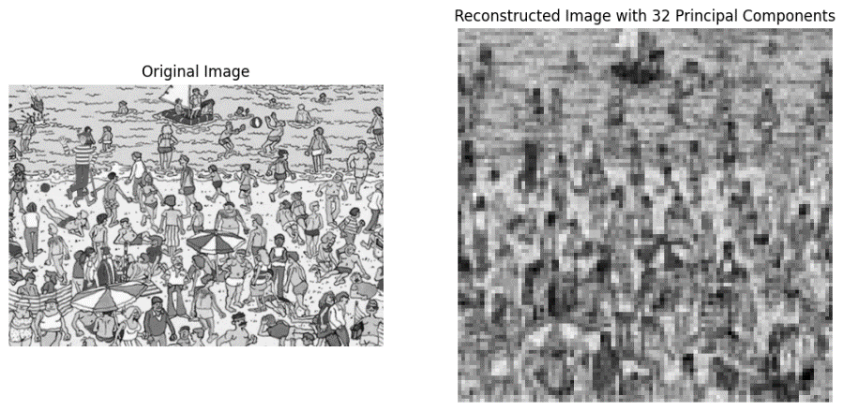
Principal Component Analysis (PCA)
PCA method didn’t work well…
PCA, or Principal Component Analysis,
is a dimensionality reduction technique commonly used in machine learning and data analysis.
The main idea is to transform the original high-dimensional data into a lower-dimensional space while preserving most of the data's information (i.e., variance).
The new dimensions, called principal components, are linear combinations of the original features and are orthogonal to each other.

Slide 6
Principal Component Analysis (PCA)
Inappropriate for object detection
PCA is a dimensionality reduction technique primarily used for compressing data and reducing noise.
It is not designed for object detection tasks like finding Waldo, which require the identification of specific patterns and features in the image.
As a result, the PCA-transformed images might not contain the information needed for successful detection.

Slide 7
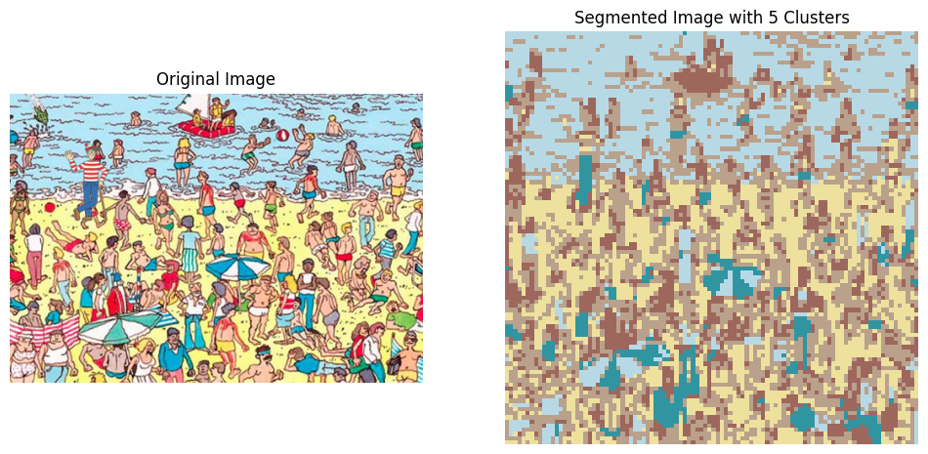
K-means Clustering
K-mean clustering didn’t work well…
K-means clustering is an unsupervised machine learning algorithm
Used to partition data points into a specified number of clusters (k) based on their similarity.

Slide 8
K-means Clustering
Assumes equal-sized clusters
K-means clustering assumes that the clusters are roughly equal in size, which might not hold in the "Finding Waldo" problem.
Waldo is a small object in a large and complex scene, and using K-means clustering may result in inappropriate cluster assignments, leading to poor object detection performance.

Slide 9
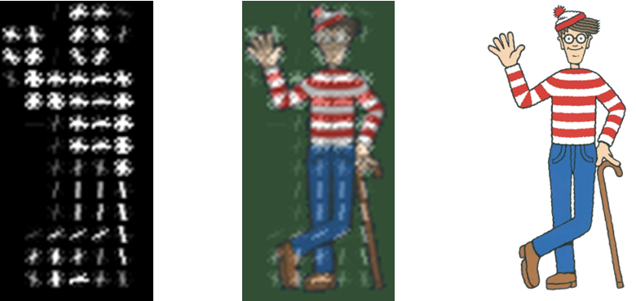
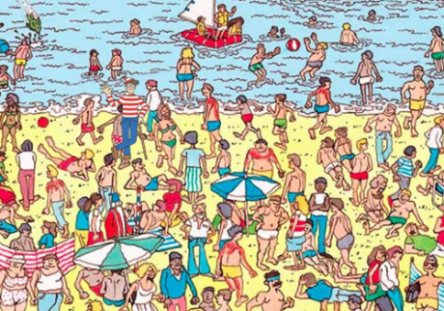
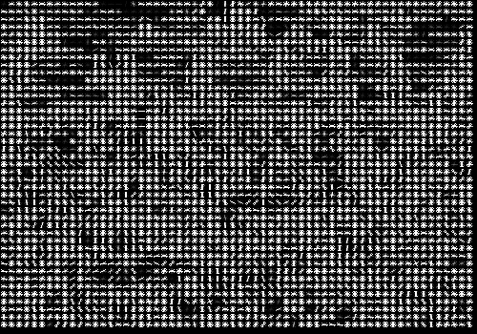
Histogram of Oriented Gradients (HOG)
It work well!
The Histogram of Oriented Gradients (HOG) is a popular feature extraction technique used in computer vision and image processing tasks, such as object detection and recognition.
The primary idea behind HOG is to capture the shape and appearance of an object by analyzing the distribution and orientation of intensity gradients in an image.

Slide 10
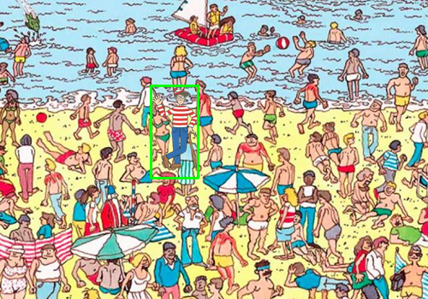
Histogram of Oriented Gradients (HOG)

Slide 11
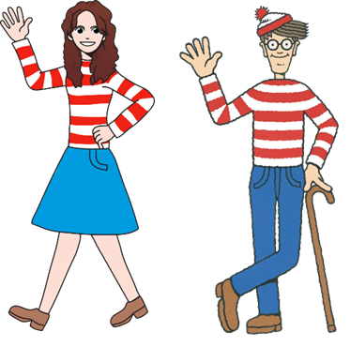
Problem
We needed to use binary classification.
In the "Finding Waldo" task, one challenge encountered when using HOG as a feature descriptor is the presence of visually similar characters, such as Wilma, who might share similar HOG features with Waldo due to their close resemblance.
This issue can lead to false positives, where the algorithm mistakenly identifies Wilma as Waldo.

Slide 12
Steps for the solution(Binary)
Extract HOG features for both the input image and the Waldo template.
Perform template matching using HOG features of the input image and the Waldo template.
Calculate the Intersection over Union (IoU) between the predicted and ground truth bounding boxes. If the IoU is greater than or equal to 0.5, it suggests that the matched section is correct.

Slide 13
Steps for the solution(Binary)
Calculate the difference between the HOG descriptors of the matched sub-image and the Waldo template. we have used the L2-norm to compute the difference between the HOG features. If this difference is less than or equal to the threshold it indicates that the matched character is Waldo. Otherwise, the matched character is considered different.
Iterate through all the images in the dataset, applying the find_waldo function and counting the number of correct identifications. The overall accuracy of the model is then calculated and reported.

Slide 14
Using Waldo template to find Waldo
The accuracy = 100%
We used 30 different background images and the codes detected where the waldo is with the accuracy of 100%. This task showcases the ability of our machine learning model to effectively recognize a specific target amidst a complex and cluttered environment.

Slide 15
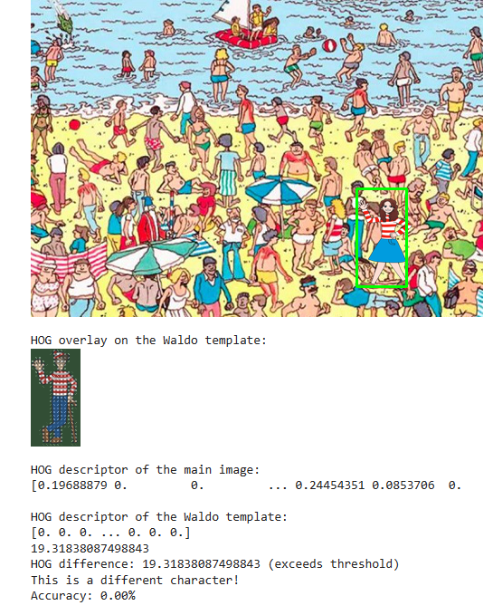
Classifying non-Waldo(Wilma) image
Our code classifies with 100% that it is not Waldo
we utilized the Waldo template to classify and differentiate Wilma within 30 background images.
By successfully identifying that the images containing Wilma did not feature Waldo, we demonstrated the model's robustness and effectiveness in distinguishing between characters with similar appearances.
This highlights the model's capability to prevent false-positive detections and accurately locates Waldo in complex and cluttered scenes.
(In the image, it shows 0% accuracy, and it means non of them are Waldo and that is correct!

Slide 16
Binary Classification using alternative methods
We separated our images into Waldo and non-waldo(Wilma).
if (foldername=='waldo'):
labels.append(1)
else:
labels.append(0)
Then…We train our model using 4 different methods

Slide 17
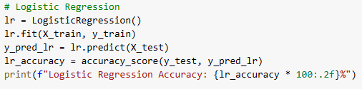
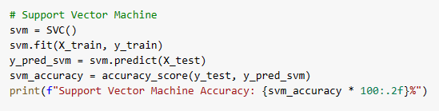
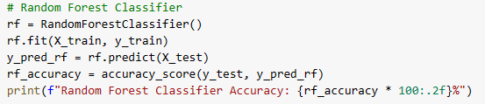
Other methods
Logistic Regression Accuracy: 57.50% (It is not good!)
Support Vector Machine Accuracy: 56.25% (It is not good!)
Random Forest Classifier Accuracy: 57.50% (It is not good!)

Slide 18
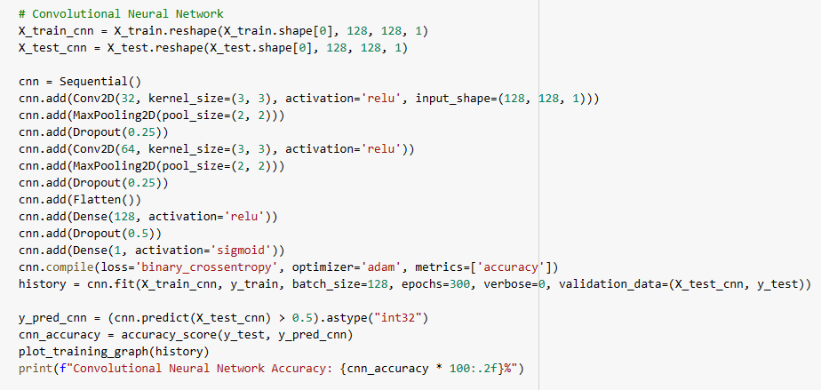
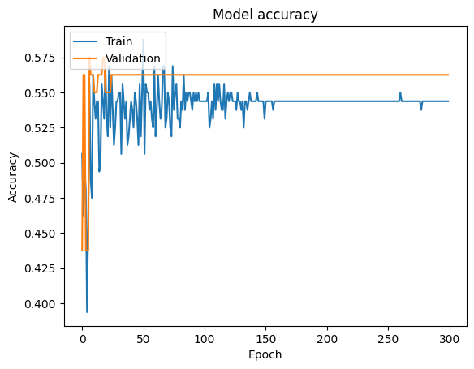
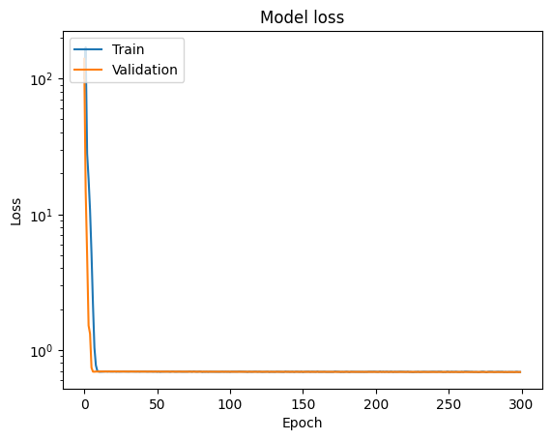
Other methods
Convolutional Neural Network Accuracy: 56.25% (It is not good!)

Slide 19

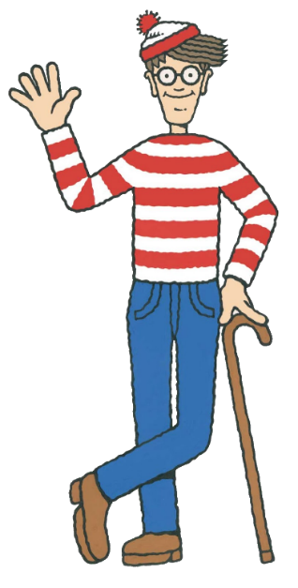
Back to the original algorithm
Our code worked better for finding Waldo
We thought the Waldo template is like a key and fingerprints.
And since we know the pattern, of the Waldo, it was better to just compare to the image in the background.

Slide 20
Back to the original algorithm
Now, we designed our code to…
Performed template matching using the HOG features of both Waldo and Wilma templates and computed the locations with the highest similarity.
Extracted matched sub-images for both Waldo and Wilma, computed their HOG features, and calculated the difference between the HOG descriptors.
We classified the image as either Waldo or Wilma based on the more negligible difference between HOG descriptors.

Slide 21
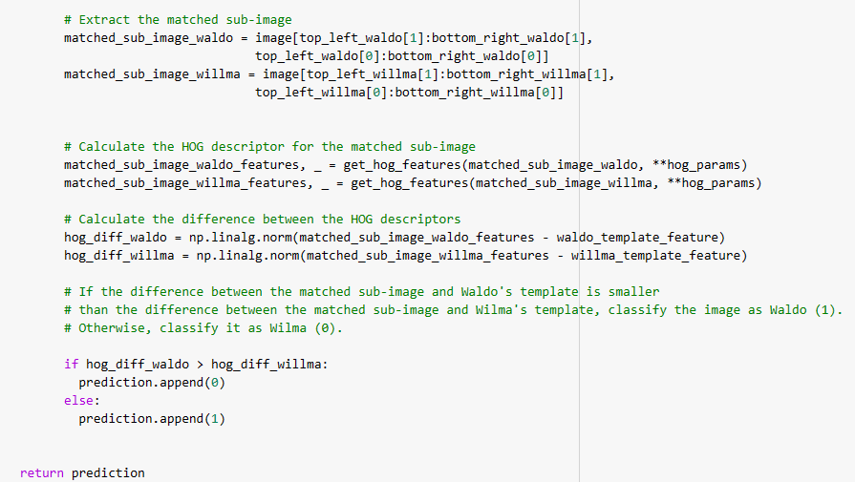
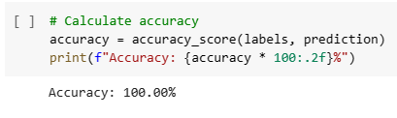
Back to the original algorithm
Now, we designed our code to…
We used 240 images
Our algorithm classified Wilma and Waldo image with the accuracy of 100%!

Slide 22
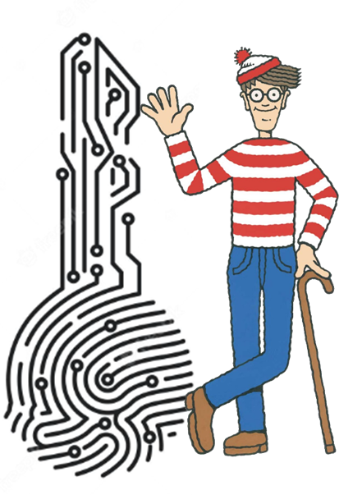
Conclusion
Why the original algorithm worked better?...
HOG captures the object's shape and edge information well, which is essential when identifying characters like Waldo and Wilma, who have distinct appearances.
Using a template-matching approach, the algorithm explicitly searches for the features present in the templates (Waldo and Wilma). This allows the algorithm to focus on the most relevant information for the classification task, making it more accurate than methods that need to learn the relevant features from scratch.

Slide 23
Conclusion
Why the original algorithm worked better?...
Because our dataset is relatively small, more is needed to effectively train a CNN, which usually requires large amounts of data to achieve high performance.
HOG and template matching can work better in such cases, as they rely on hand-crafted features that are already known to be effective in detecting the target objects.

Slide 24
Conclusion
Why the original algorithm worked better?...
Our best model was using HOG feature extraction with l2 norm to find the difference + Binary classification.
Other classification combined difference method, but they didn’t work well with low accuracy.

Slide 25
Thank you for listening!

